Slide 1
Burnett County Comprehensive Plan
Vision 2030
Burnett County, Villages of Grantsburg and Webster, Towns of Anderson, Daniels, Dewey, Jackson, Oakland, Sand Lake, Siren, Trade Lake, Union, Webb Lake, Wood River

Slide 2
Process
Side board approach
Developing plans from the bottom up with dialogue
CPC consists of: The Land Use and Information Committee plus one County Board Supervisor, and a non-voting representative from each town, village and the St. Croix Tribe

Slide 3
Consistency
Decisions relating to the “official map”, subdivisions, and zoning must be consistent with a adopted comprehensive plan that meets state standards
“Consistency” means decisions must be compatible with the future land use map and recommended policies.

Slide 4
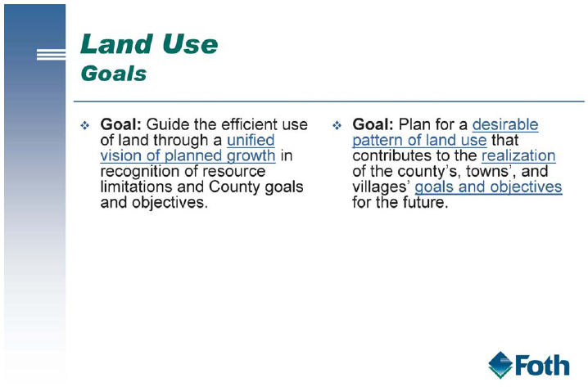
Land Use Goals

Slide 5
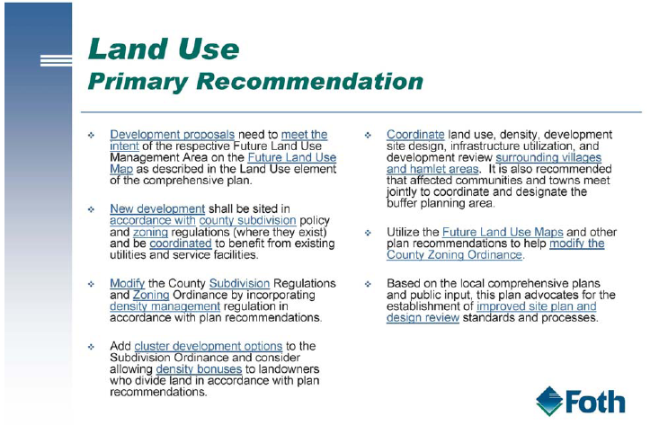
Land Use Recommendations

Slide 6
Land Use
Focus development in villages when possible
Net density management

Slide 7
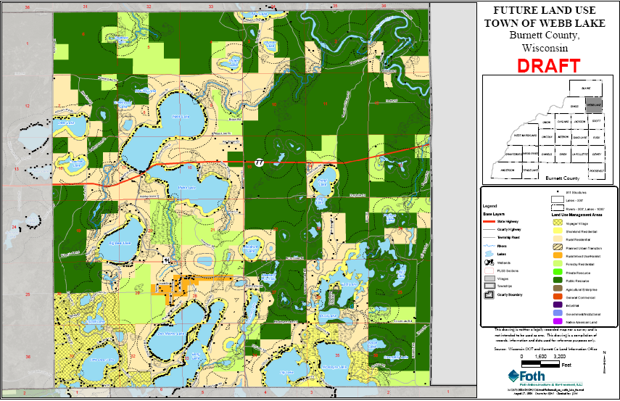
Future Land Use Map

Slide 8
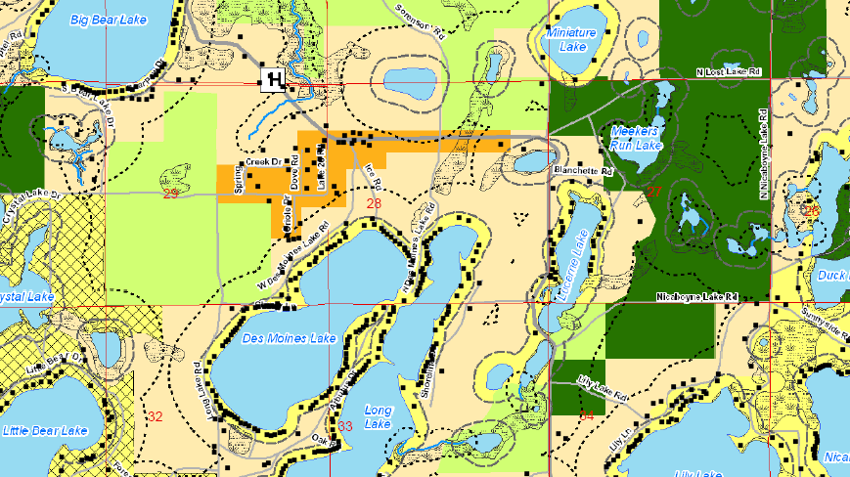

Slide 9
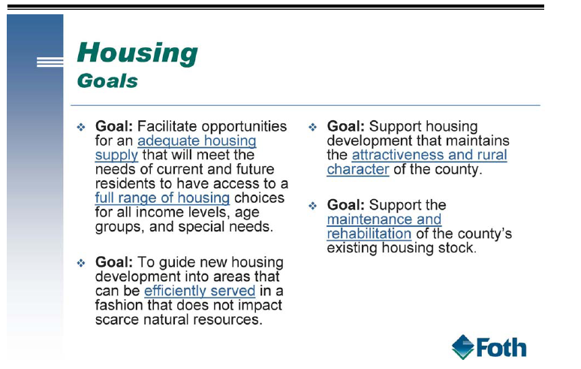
Housing

Slide 10
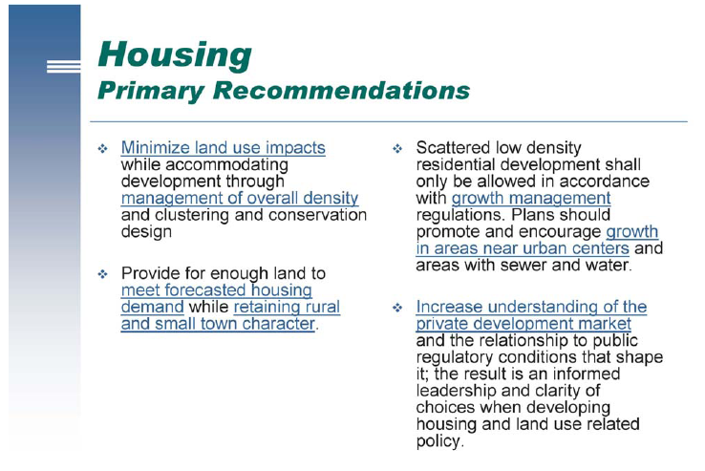

Slide 11
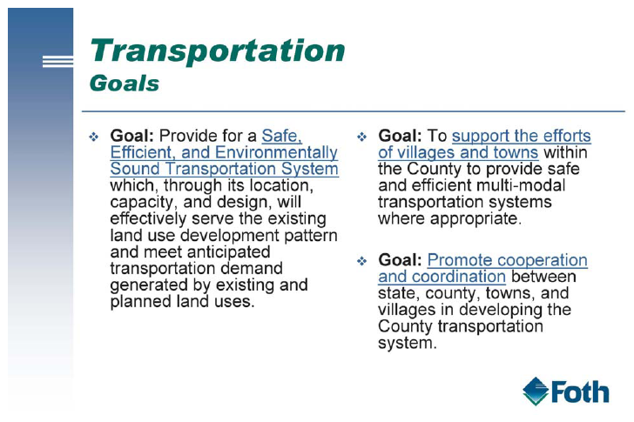
Transportation

Slide 12
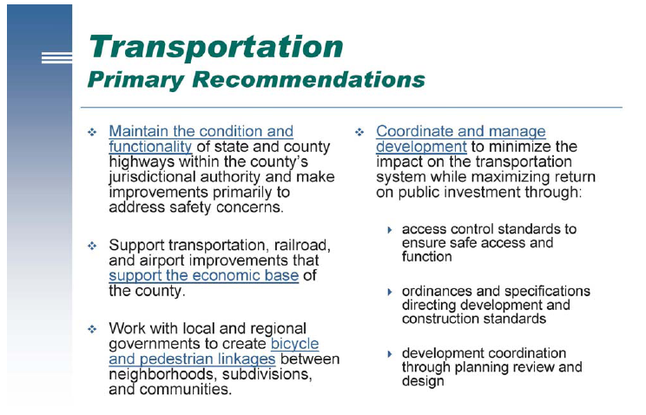

Slide 13
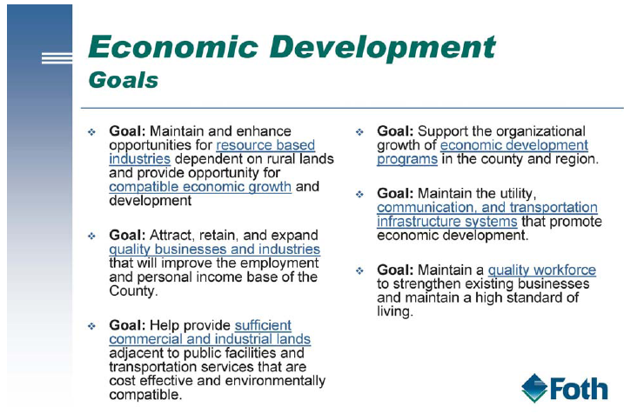
Economic Development

Slide 14
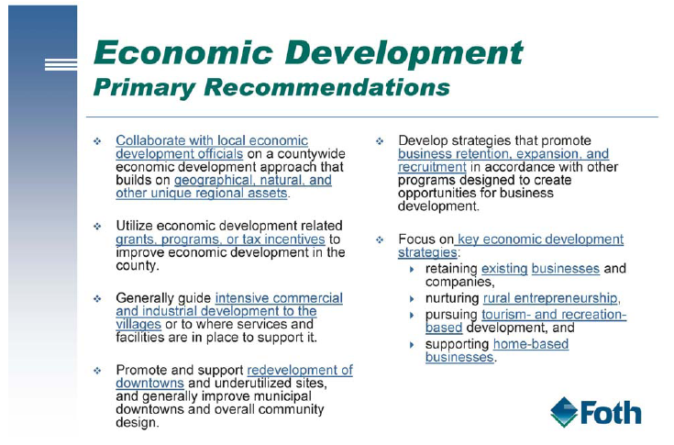

Slide 15
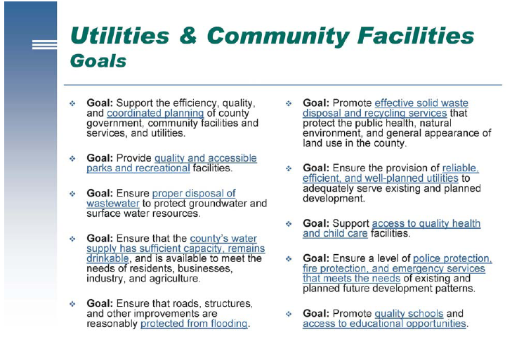
Utilities and Community Facilities

Slide 16
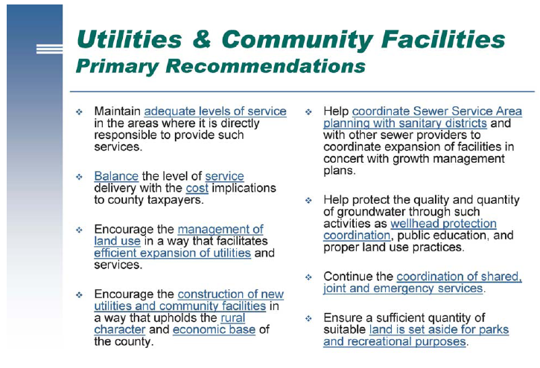

Slide 17
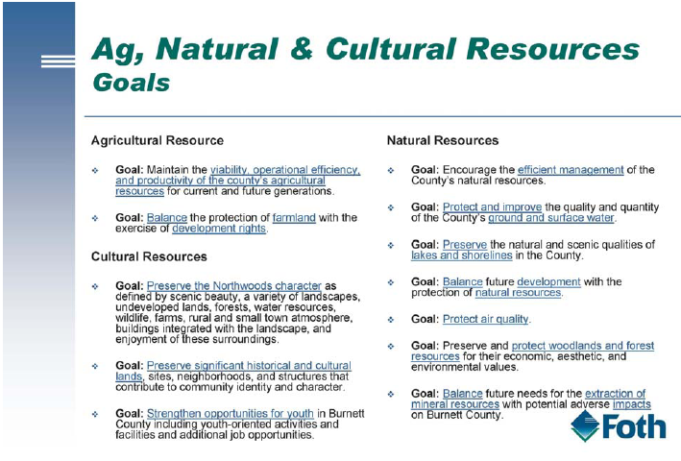
Natural Resources

Slide 18
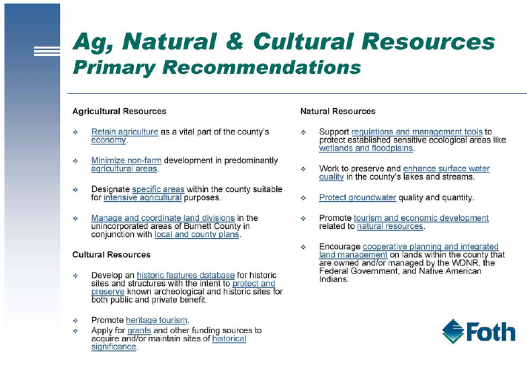

Slide 19
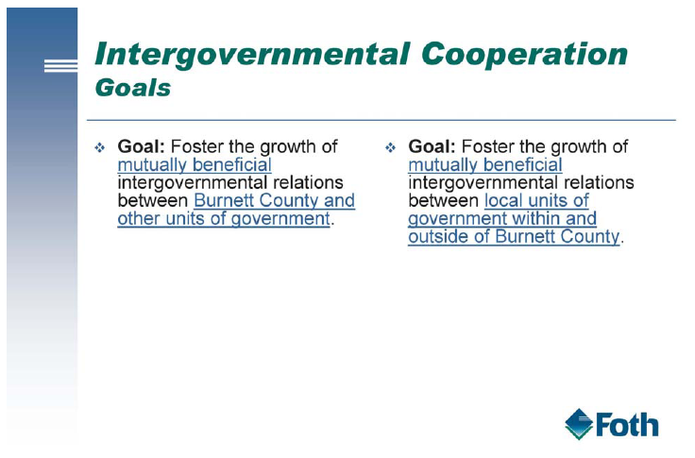
Intergovernmental Cooperation

Slide 20
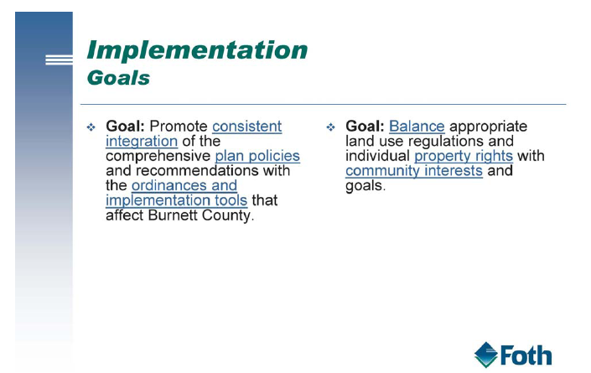
Implementation Goals

Slide 21
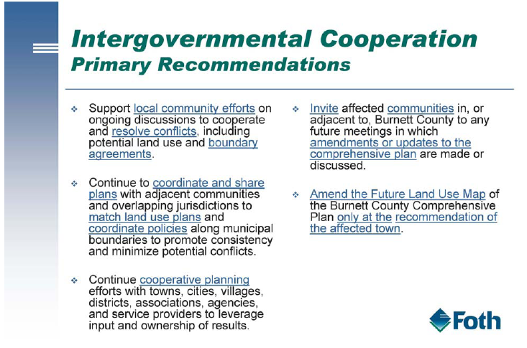

Slide 22
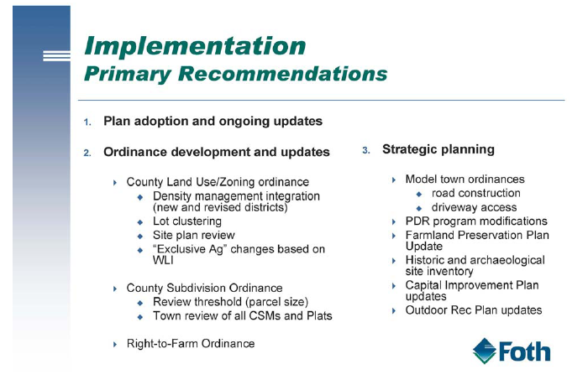
Implementation

Slide 23
Keys to implementation
Make a home for comprehensive planning within a standing or permanent committee
Create a 3 or 5 year Comprehensive Plan Action Plan and update it each year
Continue to work with towns and villages in the implementation of the comp plan, especially in land use
Meet with towns and villages at least once a year

Slide 24
Amendments

Slide 25
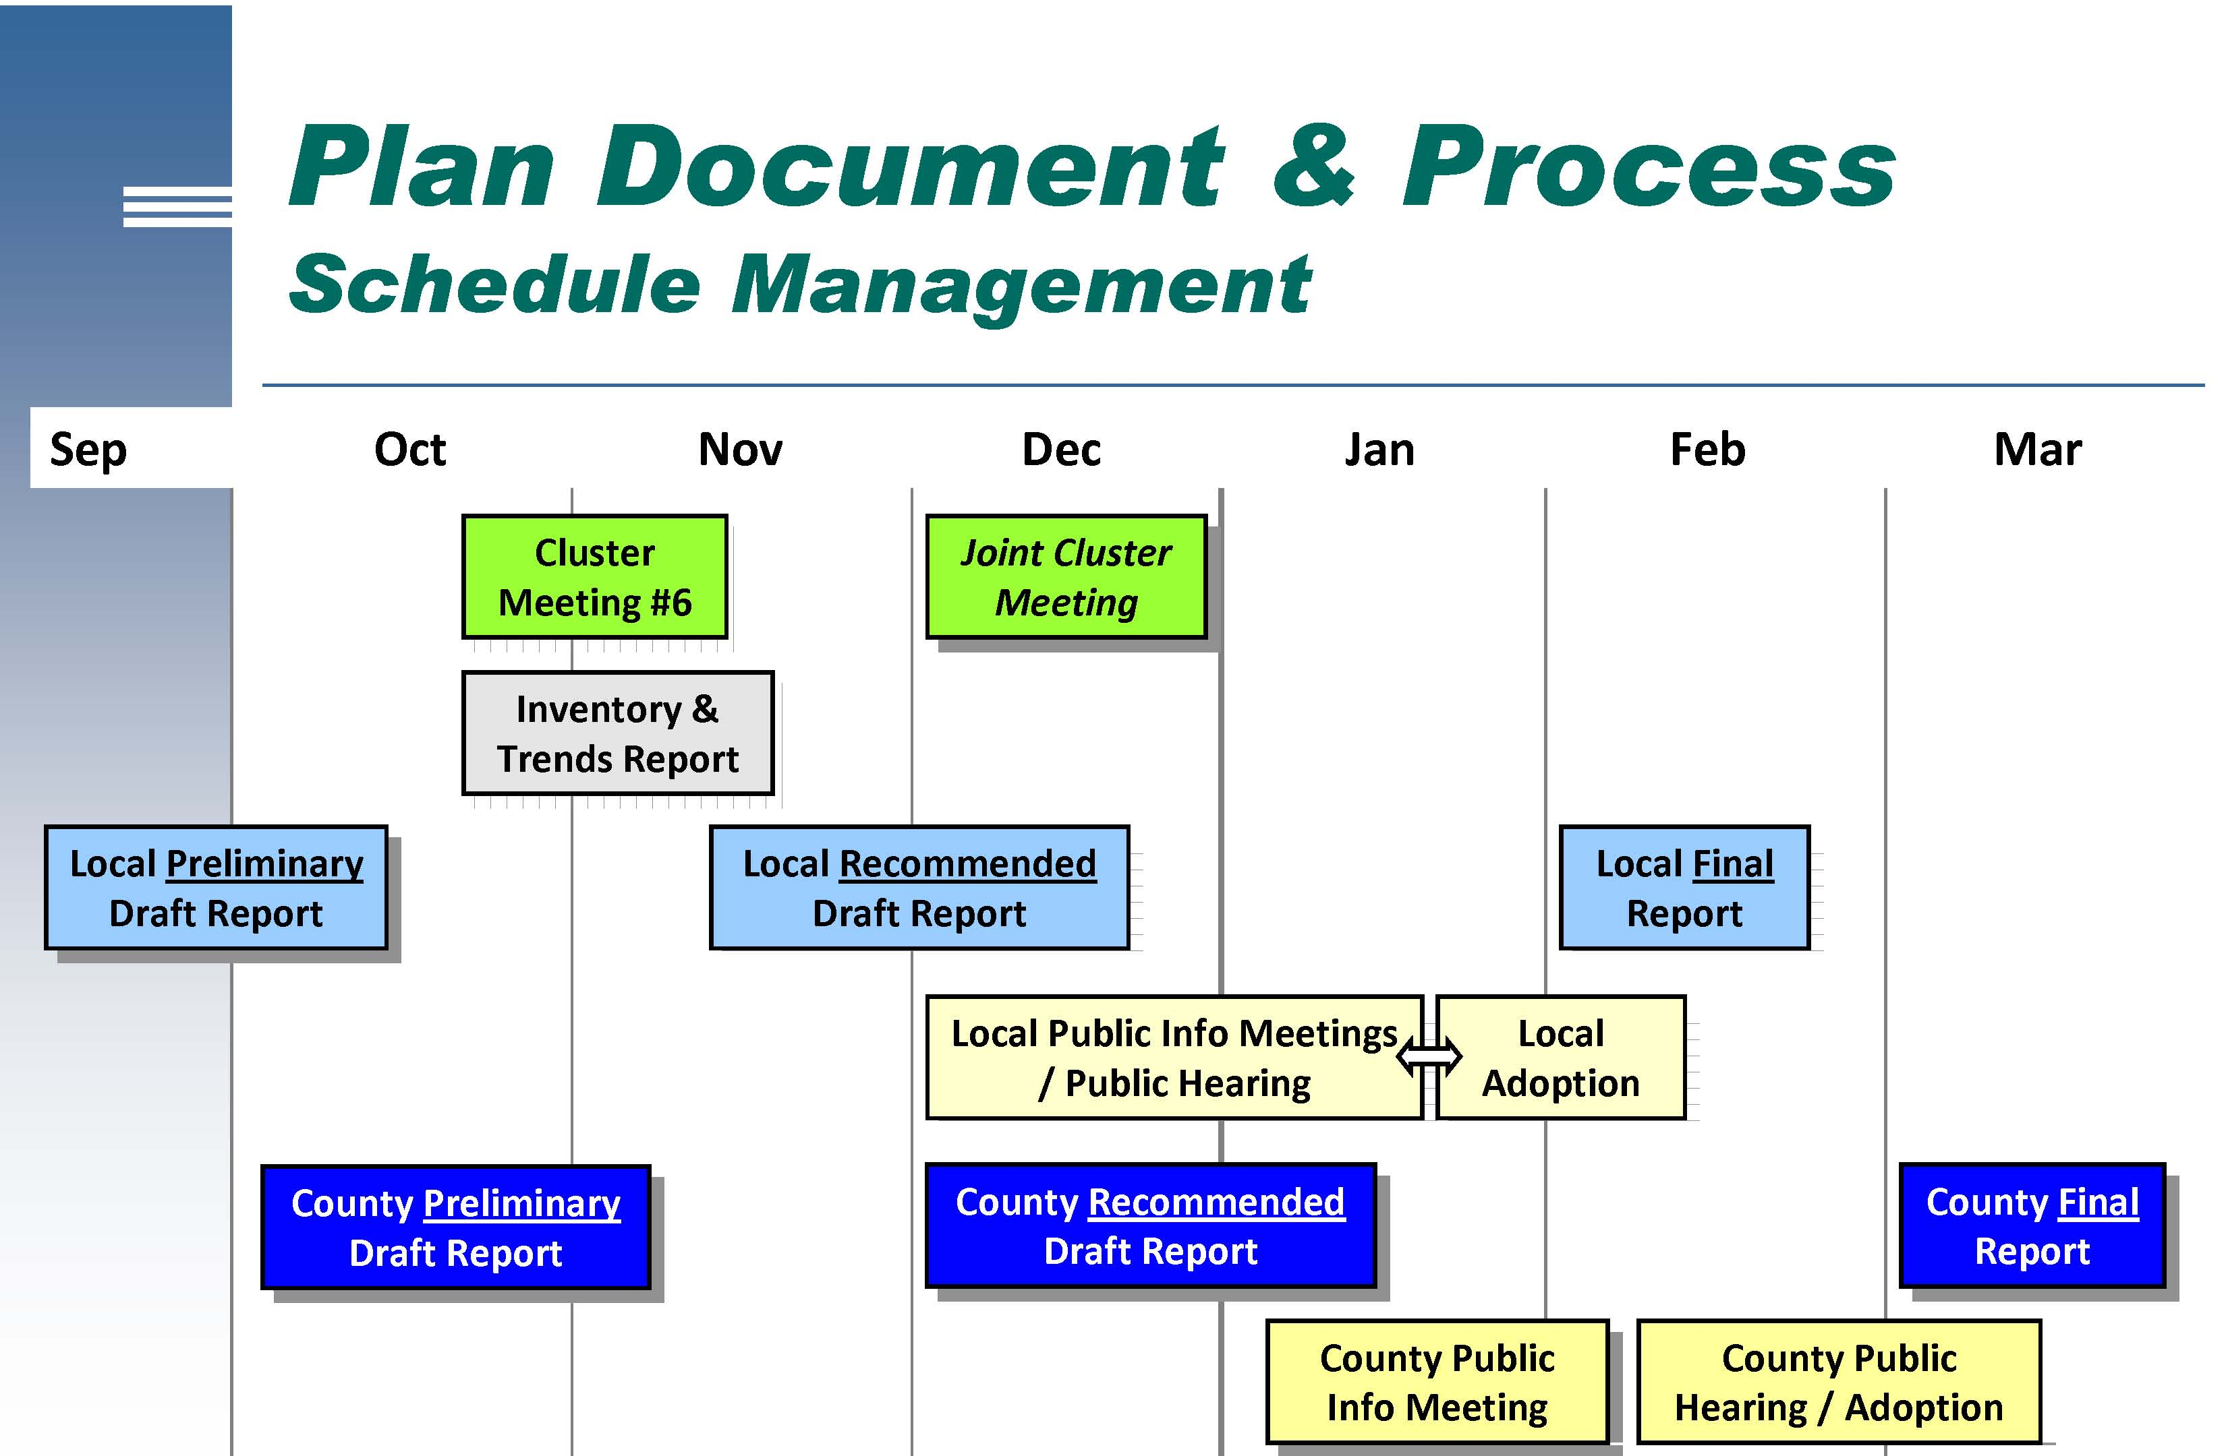
Timeline

Slide 26
Next Steps
Public Information Activities
  Newsletter to all dwelling units
  Public information meeting
  Web site updates
  Information displays
  Sharing of plan with neighboring units of government
  Public hearing
Formal recommendation by Land Use and Information Committee to County Board
Approval by ordinance by County Board

Slide 27
Upcoming meetings
Public information meeting- Jan. 19
  6:30 pm, Room 165
Public Hearing – Feb. 9
  6:30 pm, Room 165
CPC – Feb. 16;
  1 pm, Room 165
March 2 – Land Use and Information Meeting; Formal recommendation to County Board
March 18 – County Board Approval of Comp plan

Slide 28
Questions ?

